Slide 1

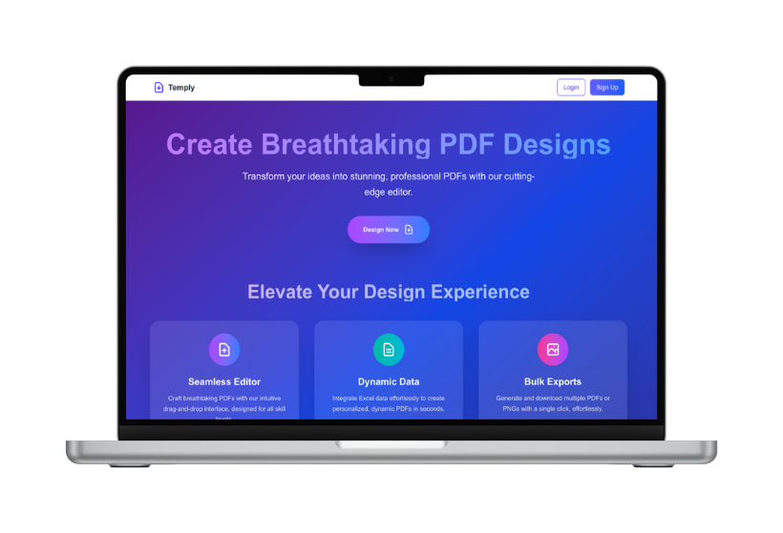
Temply
innotors.vercel.app
Pitch Deck
13 September 2025
Investor
Pitch Deck
Innovating Solutions for a Sustainable Future.
Presented by:
innotors

Slide 2
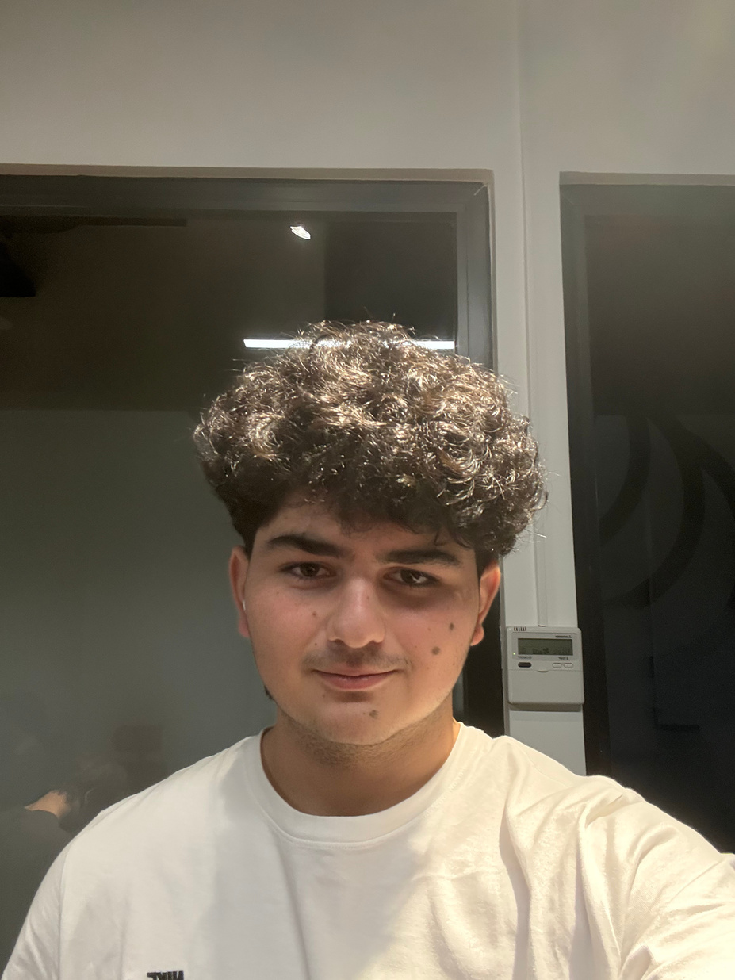
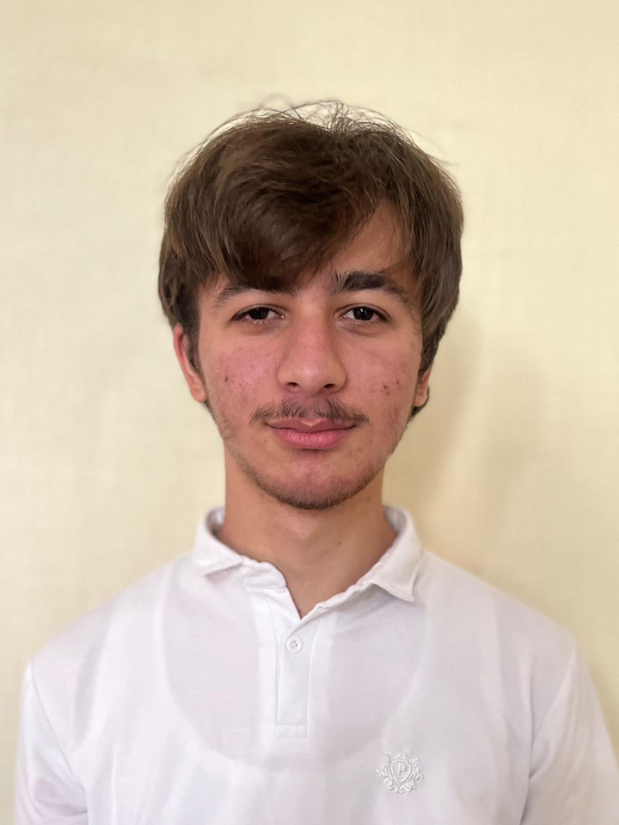
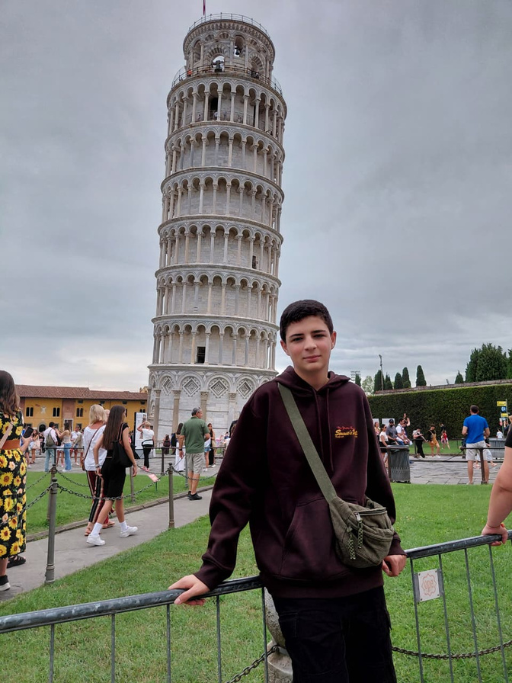
Temply
Pitch Deck
Team Overview
Team Overview
FARHAD SULTANOV, DESIGN
AMIN ASADULLAYEV, DEVELOPER
UGUR HASANOV, DESIGN

Slide 3

Temply
Pitch Deck
Problem Statement
Problem Statement
40%
of workers spend at least a quarter of their work week on manual, repetitive tasks,
“Creating large volumes of personalized documents is slow, error-prone, and inefficient.”
66%
report challenges with document approvals and reviews, particularly due to slow, manual processes.

Slide 4



Temply
Pitch Deck
Solution
Solution
“Our SaaS automates bulk document creation, allowing users to generate personalized files and more in seconds—error-free and at scale.”
Key Uses:
Event Management
Administration & Compliance
Easy to use.

Slide 5

Temply
Pitch Deck
Market Opportunity
Market Opportunity
There’s a great chance for a packaging eco park because people want green packaging, new laws are coming, and businesses need better options.
The global document management market is increasing ~10% annually. by 2027 it is projected to reach
Of companies are actively seeking automation solutions for admin and document tasks.
13.5
70%
$
/billion

Slide 6
Temply
Pitch Deck
Business Model
Business Model
We operate on a subscription-based model, with pricing starting at
9
$
/month
Our primary revenue streams include:
1.
2.
3.
Tiered monthly or annual plans.
Credits for extra document generation.
Premium templates, automation features, and API access.

Slide 7



Temply
Pitch Deck
Go-to-Market Strategy
Go-to-Market Strategy
“We’ll drive rapid adoption and scalable growth by combining targeted digital marketing, strategic partnerships with key platforms, and a freemium trial model that converts users into loyal subscribers.”
We plan to acquire customers through:
Digital marketing
Partnerships
Participating
campaigns targeting small businesses
with many other service based businesses
in trade shows and local business events.

Slide 8
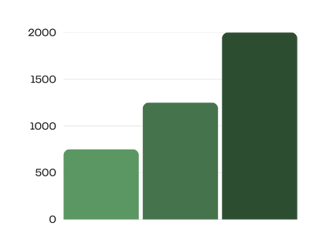


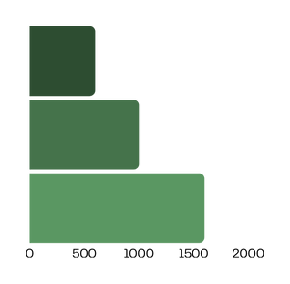
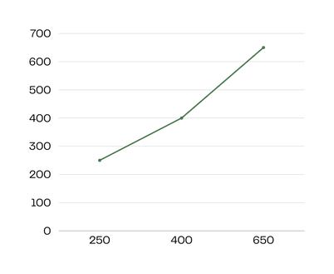
Temply
Pitch Deck
Financial Projections
Financial Projections
Projected Revenue
Anticipated Profit Margin
$2,000,000
33.3%
33.3%
$1,250,000
$750,000
33.3%
2025
2026
2027
2025
2026
2027
Gross Profit
Operational Costs
2025
$600,000
2027
2026
$1,000,000
2026
Financial projections in packaging Ecopark content show how much money a project will make and spend. They help companies plan their green projects and get investors.
2025
2027
$1,600,000

Slide 9

Temply
Pitch Deck
Funding Ask
Funding Ask
We are seeking $150,000 to scale our operations. Funds will be allocated to
$67,500
$52,500
$22,500
Product development
Marketing & Customer Acquisition
Team & Operations

Slide 10


Temply
Pitch Deck
“We welcome your questions and feedback.”
Please reach out at

Slide 11
Temply
Pitch Deck
Thank you!
Thank you
for considering
Temply
Functional Prototype
Clear Benefits
Open Data: N/A
GitHub Push
Vercel Pages
We’re excited about the opportunity to partner with you in creating a sustainable future!

